Slide 1
Chapter 6
Some Continuous Probability Distributions
Chapter 6
Some Continuous Probability Distributions

Slide 2
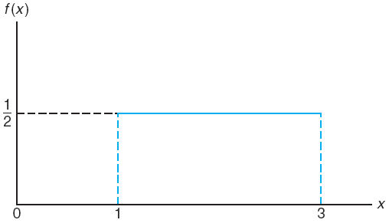
Chapter 6.1
Continuous Uniform Distribution
Continuous Uniform Distribution
|Uniform Distribution| The density function of the continuous uniform random variable X on the interval [A, B] is
The mean and variance of the uniform distribution are
and
The uniform density function for a random variable on the interval [1, 3]

Slide 3
Chapter 6.1
Continuous Uniform Distribution
Continuous Uniform Distribution
Suppose that a large conference room for a certain company can be reserved for no more than 4 hours. However, the use of the conference room is such that both long and short conference occur quite often. In fact, it can be assumed that length X of a conference has a uniform distribution on the interval [0, 4].
What is the probability density function?
What is the probability that any given conference lasts at least 3 hours?

Slide 4
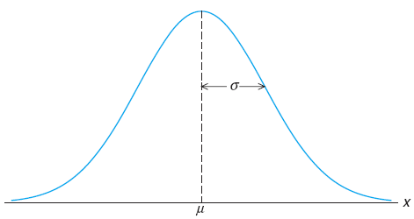
Chapter 6.2
Normal Distribution
Normal Distribution
Normal distribution is the most important continuous probability distribution in the entire field of statistics.
Its graph, called the normal curve, is the bell-shaped curve which describes approximately many phenomena that occur in nature, industry, and research.
The normal distribution is often referred to as the Gaussian distribution, in honor of Karl Friedrich Gauss, who also derived its equation from a study of errors in repeated measurements of the same quantity.
The normal curve

Slide 5
Chapter 6.2
Normal Distribution
Normal Distribution
A continuous random variable X having the bell-shaped distribution as shown on the figure is called a normal random variable.
The density function of the normal random variable X, with mean μ and variance σ², is
where π = 3.14159... and e = 2.71828...

Slide 6
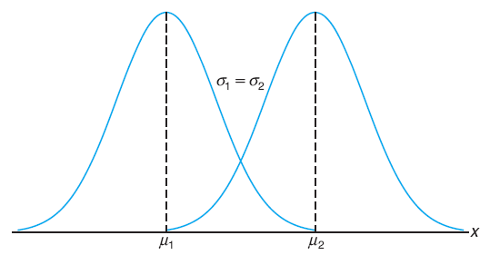
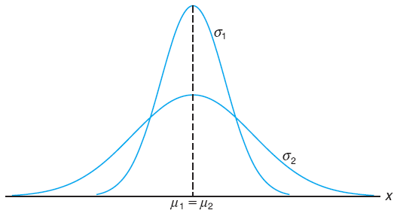
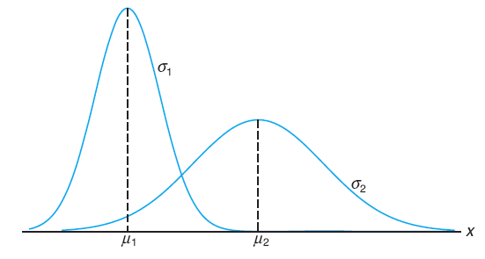
Chapter 6.2
Normal Distribution
Normal Curve
μ₁ < μ₂, σ₁ = σ₂
μ₁ = μ₂, σ₁ < σ₂
μ₁ < μ₂, σ₁ < σ₂

Slide 7
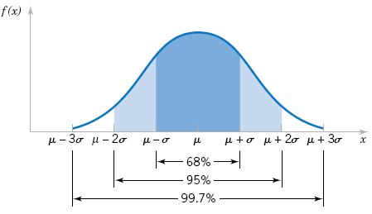
Chapter 6.2
Normal Distribution
Normal Curve
f(x)
The mode, the point where the curve is at maximum
Concave downward
Point of inflection
σ
σ
Concave upward
Approaches zero asymptotically
x
μ
Total area under the curve and above the horizontal axis is equal to 1
Symmetry about a vertical axis through the mean μ

Slide 8
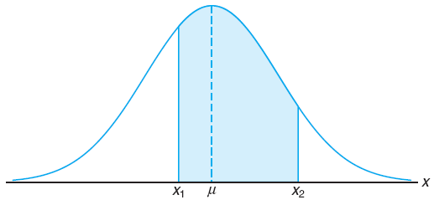
Chapter 6.3
Areas Under the Normal Curve
Area Under the Normal Curve
The area under the curve bounded by two ordinates x = x₁ and x = x₂ equals the probability that the random variable X assumes a value between x = x₁ and x = x₂.

Slide 9
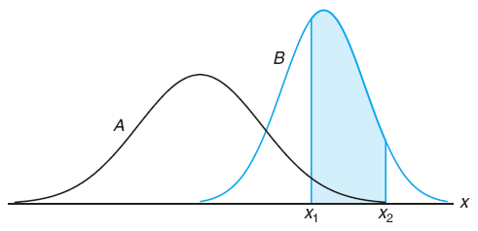
Chapter 6.3
Areas Under the Normal Curve
Area Under the Normal Curve
As seen previously, the normal curve is dependent on the mean μ and the standard deviation σ of the distribution under investigation.
The same interval of a random variable can deliver different probability if μ or σ are different.
Same interval, but different probabilities for two different normal curves

Slide 10
Chapter 6.3
Areas Under the Normal Curve
Area Under the Normal Curve
The difficulty encountered in solving integrals of normal density functions necessitates the tabulation of normal curve area for quick reference.
Fortunately, we are able to transform all the observations of any normal random variable X to a new set of observation of a normal random variable Z with mean 0 and variance 1.

Slide 11
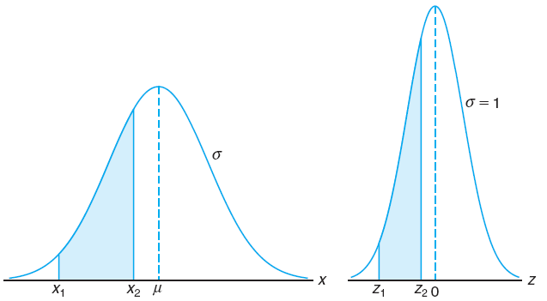
Chapter 6.3
Areas Under the Normal Curve
Area Under the Normal Curve
The distribution of a normal random variable with mean 0 and variance 1 is called a standard normal distribution.

Slide 12
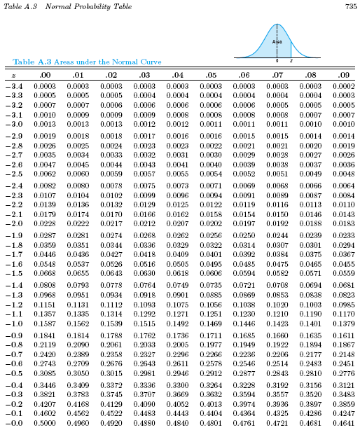
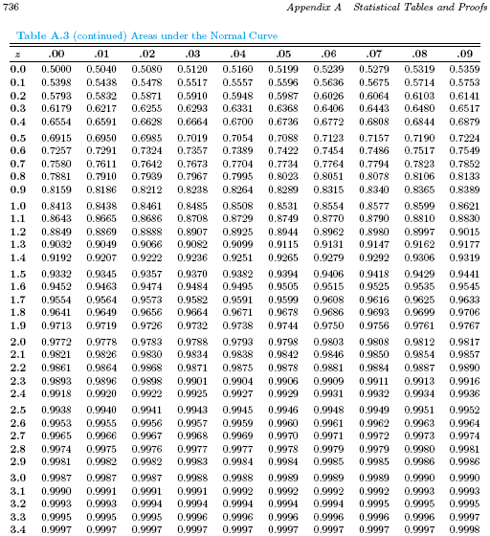
Chapter 6.3
Areas Under the Normal Curve
Table A.3 Normal Probability Table

Slide 13
Chapter 6.3
Areas Under the Normal Curve
Interpolation
Interpolation is a method of constructing new data points within the range of a discrete set of known data points.
Examine the following graph. Two data points are known, which are (a,f(a)) and (b,f(b)).
If a value of c is given, with a < c < b, then the value of f(c) can be estimated.
If a value of f(c) is given, with f(a) < f(c) < f(b), then the value of c can be estimated.

Slide 14
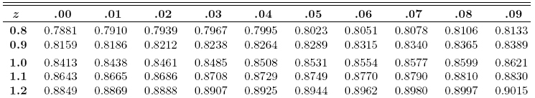
Chapter 6.3
Areas Under the Normal Curve
Interpolation
P(Z < 1.172)? Answer: 0.8794
P(Z < z) = 0.8700, z = ? 1.126

